Slide 1
MRI Breast Cancer Response to Treatment

Slide 2
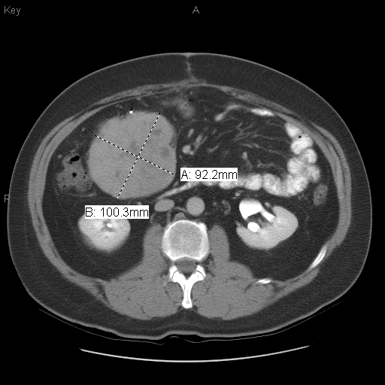
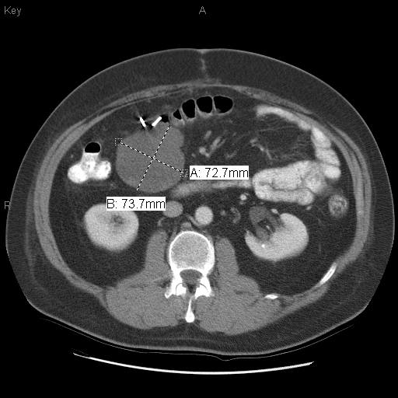
RECIST Criteria
Response Evaluation Criteria In Solid Tumors -The longest diameter of all of the target lesions in slice.
CR(disappearence), PR(decrease < 30%), PD (increase 20%), SD(small changes do not belong to PR or PD)
Baseline
8 Weeks

Slide 3
Kinetic features
Kinetic features: in DCE(Dynamic Contrast Enhanced)-MRI, MR images are acquired before and repetitively after the administration of the contrast agent.
Kinetic-curve (volume enhancement vs time points)

Slide 4
Tumor Volume
Total tumor volume:
  The summation of all the slices' segmentation.
Active tumor volume:
  The summation of all the filled segmentation.
Necrosis
  ( Total – Active ) tumor volume

Slide 5
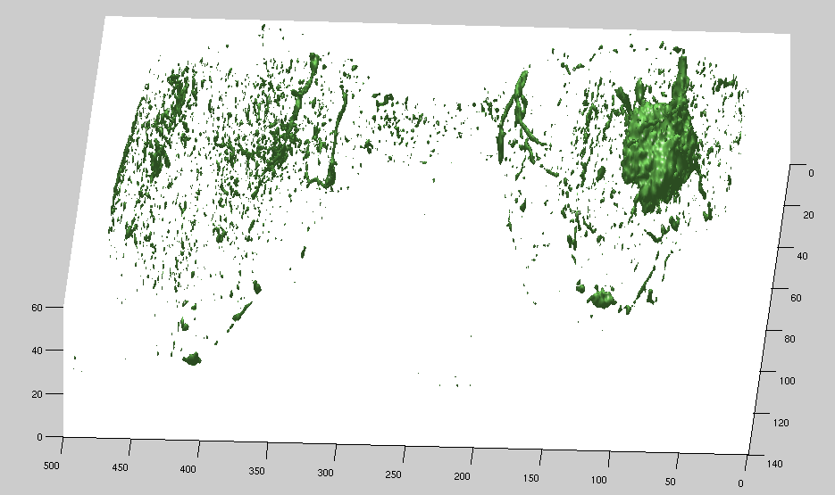
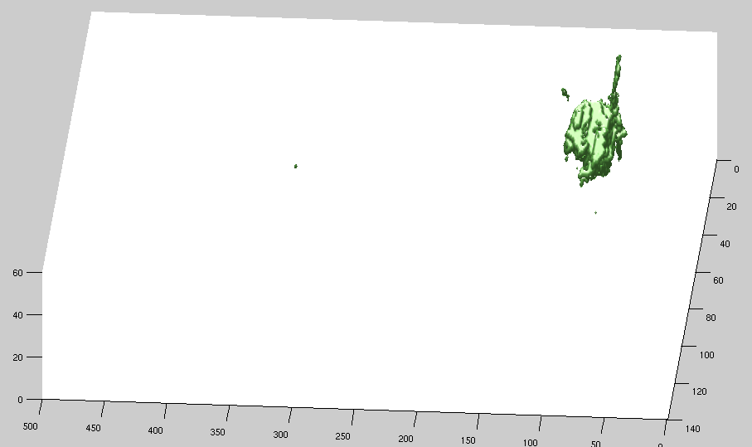
Segmentation
Original Image Isosurface
Segmentation Isosurface

Slide 6


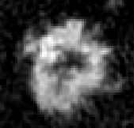

Necrosis
Segmentation
Fill the hole
Necrosis
Diameter: 43 pixels

Slide 7
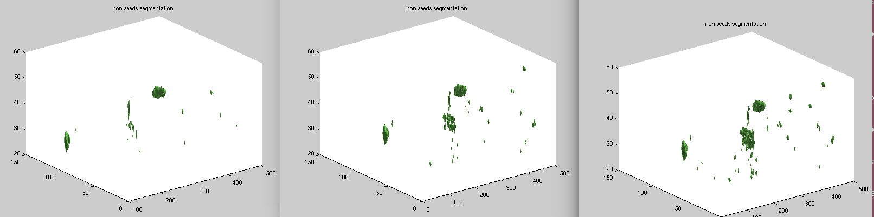
Designate 3D ROI
Segmentation
Only the interested tumor should be calculated and shown on the curve.
Designate 3D ROI

Slide 8
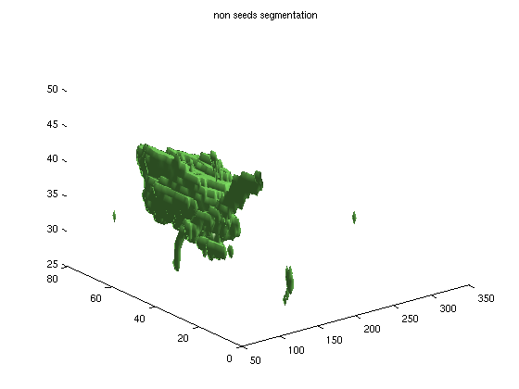
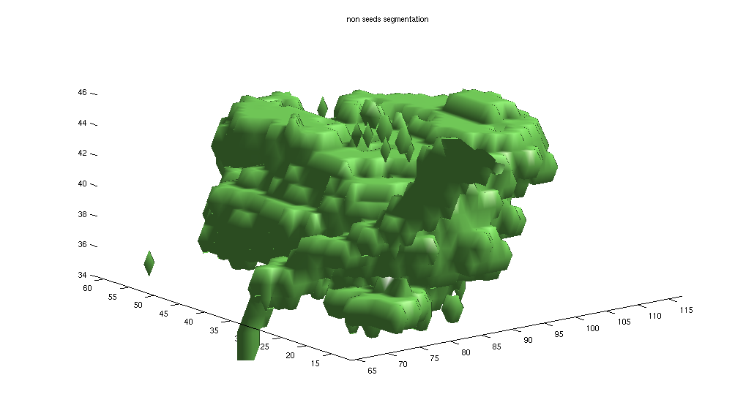
Manually designate Tumor ROI (3D)
In 19 patients data (There is no DCE-MRI data before treatment for patient #2),
Segmentation in all slices patient #1
3d-ROI from left segmentation results patient #1

Slide 9
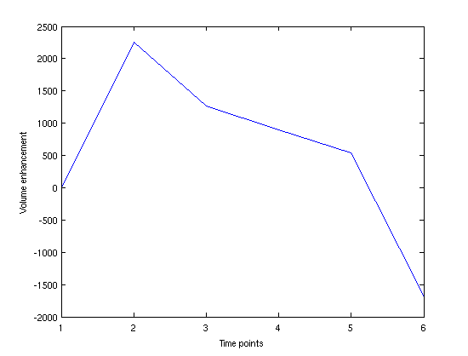
X-axis: time points
Y-axis: time-1 : 0, time-(i (2~6)): Volume(i)-Volume(i-1), while the volume's hole has been filled

Slide 10
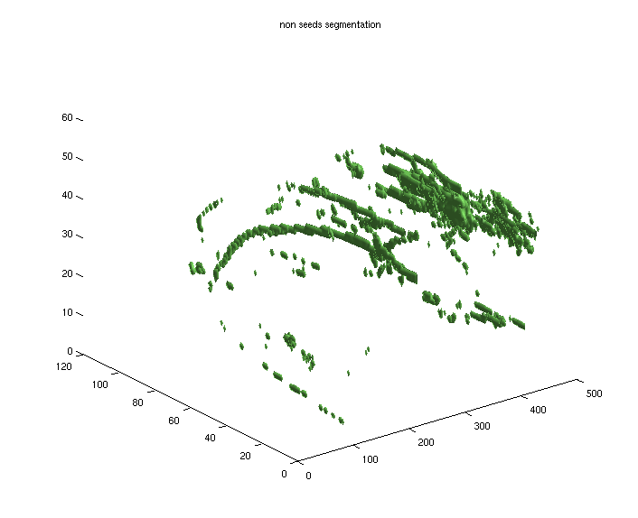
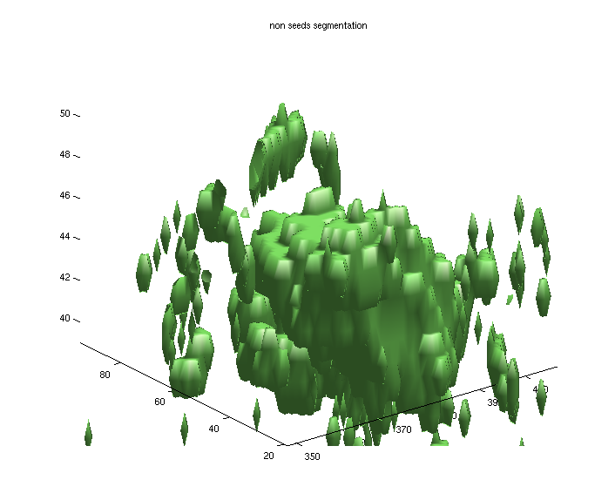
Manually designate Tumor ROI (3D)
In 19 patients data (There is no DCE-MRI data before treatment for patient #2),
Segmentation in all slices patient #3
3d-ROI from left segmentation results patient #3

Slide 11
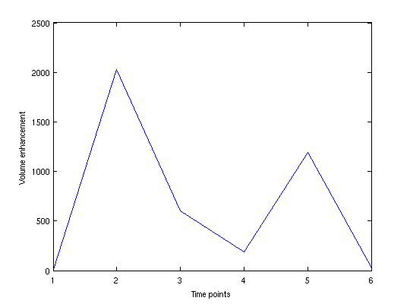

Slide 12
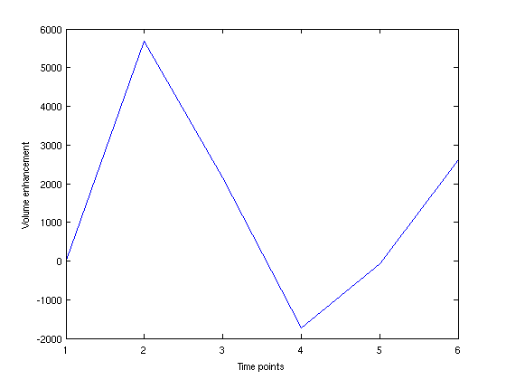
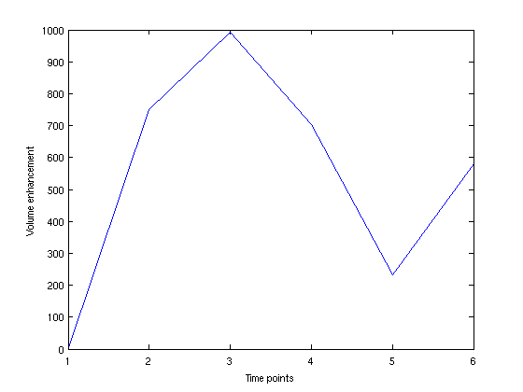
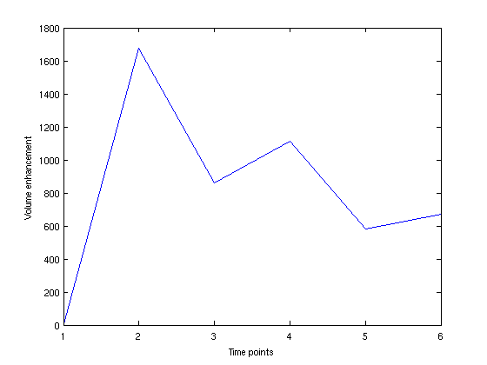
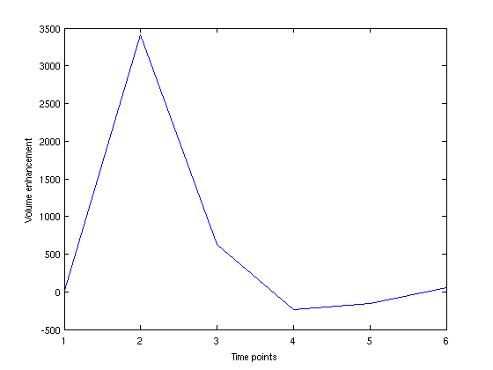
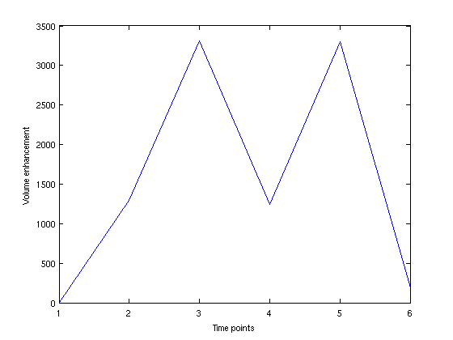
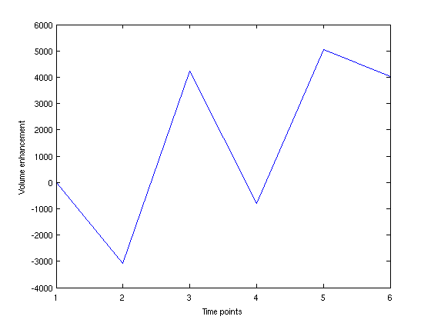
The curve from patient 4 to 9

Slide 13
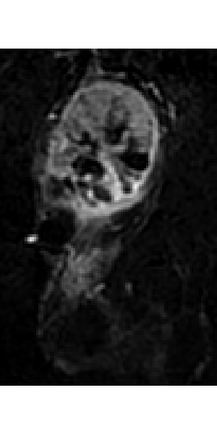
The cancer data (ambiguious)
Patient 9. I am not sure the whether periphrial part need to be considered.
Currently, only the red circle is considered

Slide 14
The cancer data (ambiguious)
For some data, there are just a 3-d (without hole), what is the point to calculate the change? (patient 10)?

Slide 16
DNN

